Slide 1
INFO3141 – MidTerm Yug Shah-y_shah142873
Screenshots of the wireframe as instructed in the MidTerm Practical PDF

Slide 2
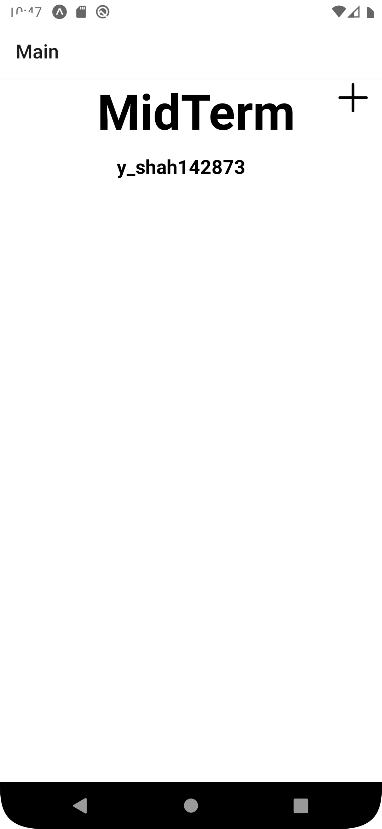
ScreenShot #1 – Main Screen with no entries

Slide 3
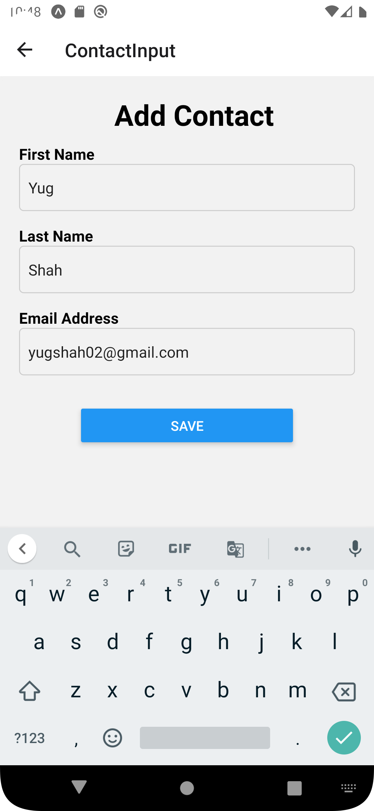
Screenshot #2 – Contact Details Screen

Slide 4
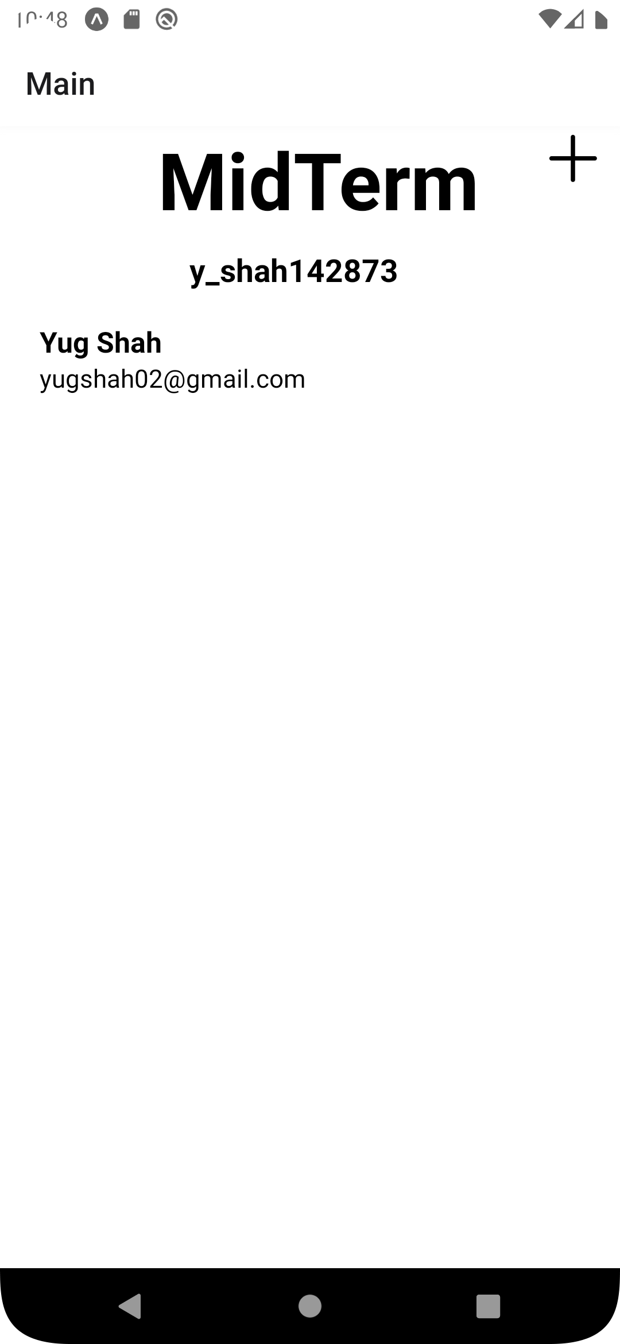
Screenshot #3 – Main Screen with Contact Details

Slide 5
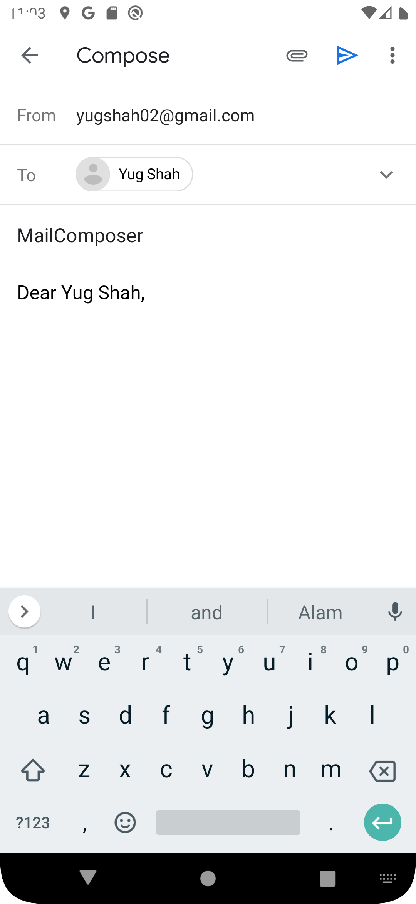
Screenshot #4 – Email App with Details

Slide 6
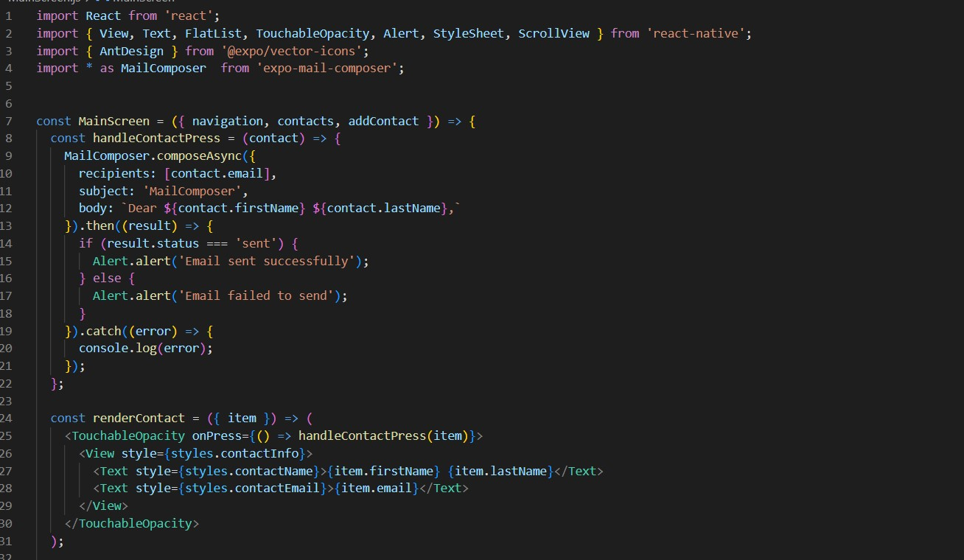
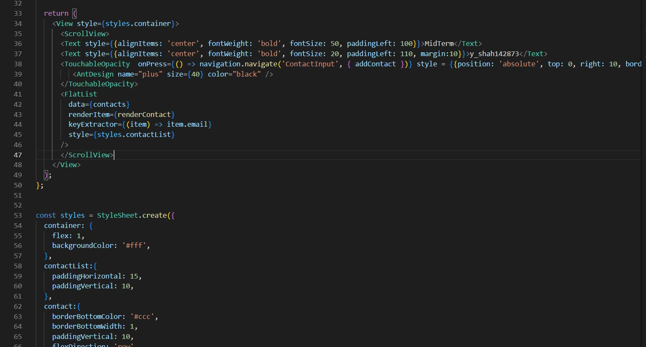
Screenshot #5 – Alert message(screenshot of Code)

Slide 7
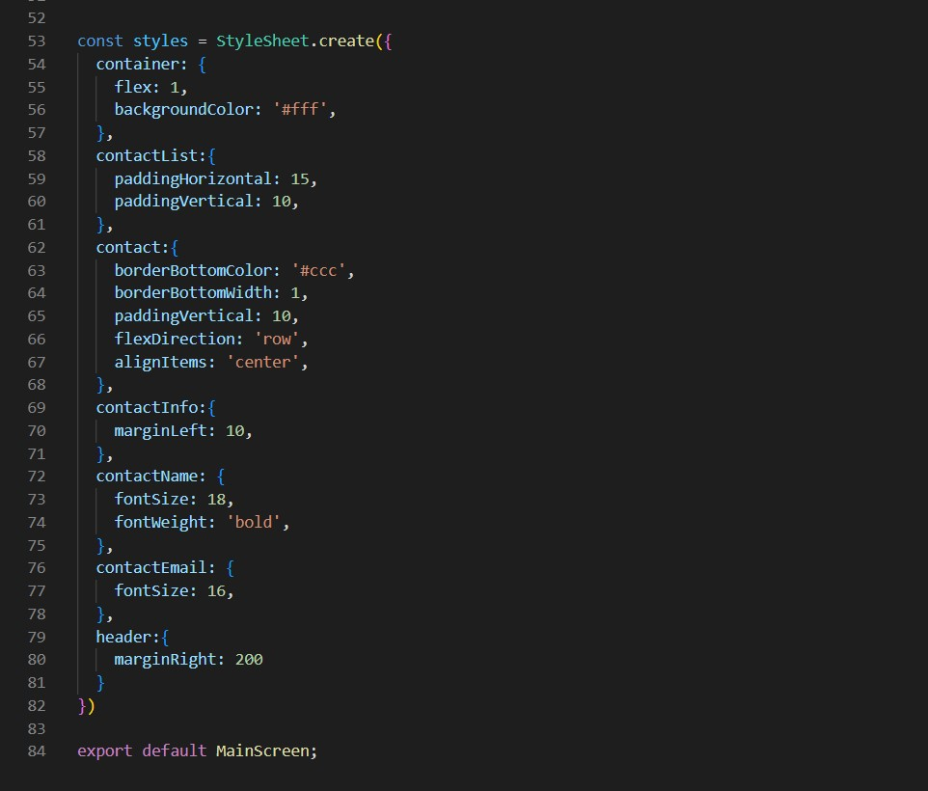
Screenshot #5 – Alert message (screenshot of Code)

